Slide 1
Descriptive and inferential statistical methodologies has proven effective in creating a proactive ‘alarm’, identifying Horse Power (R Value), Volumetric Flow Meter 1 (R Value) and Pump Efficiency (R Value) emerging as key variables of interest that have high correlations associated with Pump Failure.

Slide 2
Descriptive Analysis has enabled us to clearly identify particular signature abnormalities showing clear signature changes in both Rolling Standard Deviation and Rolling Mean Datasets when observed over the respective failure period of interest.

Slide 3
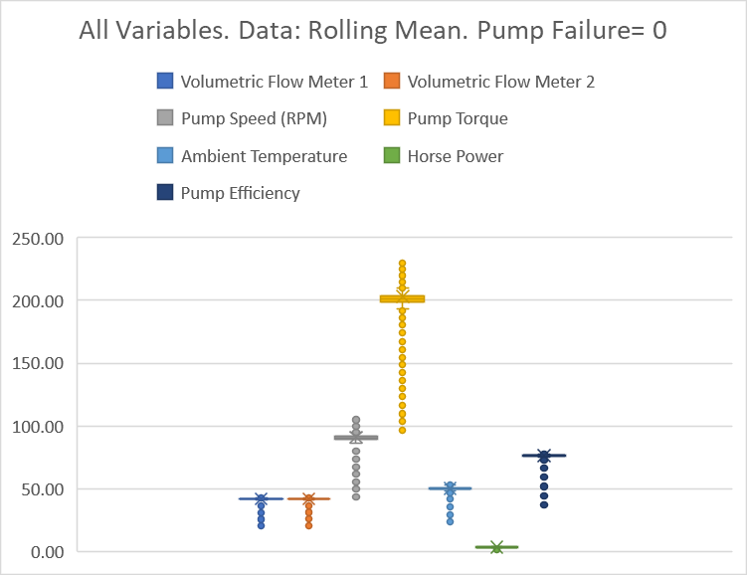
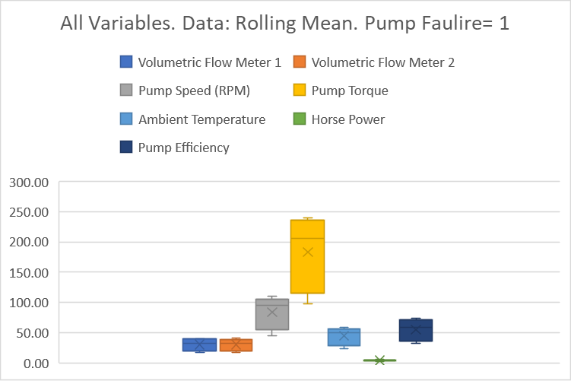
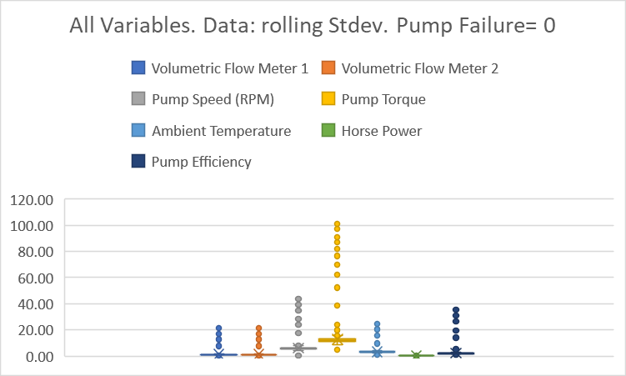
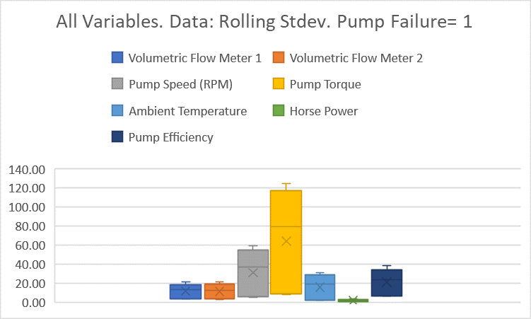
Further segmentation of the data via binary means (Pump Failure = 0 or 1) illustrated through box and whisker plots show a clear signature difference between that of normal behaviour and that of Failure with Pump Torque, Pump Speed Pump Efficiency showing the 3 largest variances.

Slide 4
Correlation analyses across datasets yield interesting insights with Pump Efficiency and Volumetric Flow negatively correlated with Pump Failure in the Rolling Data, whilst they both then show a subsequently strong positive correlation in the Rolling Stdev Dataset.
Correlation Strength

Slide 5
Lastly, analysis of the model fit reveals that with a R Squared of 0.77 a linear model is a good fit for the data with variables Horse Power, Pump Efficiency and Volumetric Flow Meter 1 having the largest coefficients, indicative that these variables have the most immediate relationship with respect to Pump Failure behaviour.

